Slide 1
Masa i energia w środowisku w kontekście zmiany klimatu
Bogdan Chojnicki
Pracownia Bioklimatologii
Katedra Ekologii i Ochrony Środowiska
Uniwersytet Przyrodniczy w Poznaniu

Slide 2
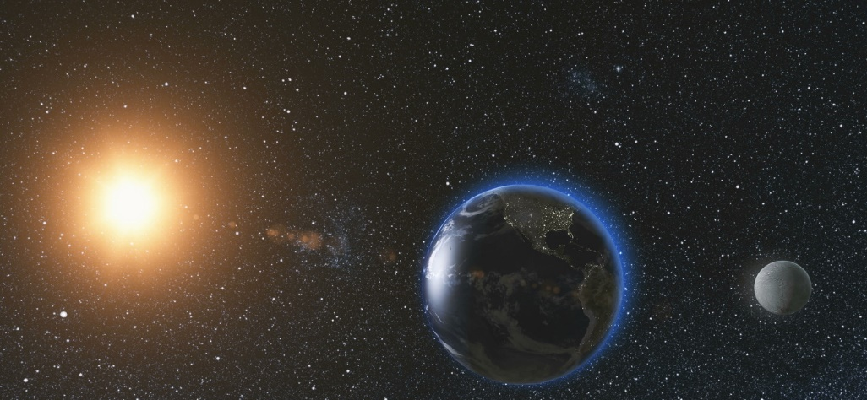
Earth-Atmosphere system
Matter circulation
Short-wave radiation energy flux
Energy flow
Long-wave radiation energy flux

Slide 3
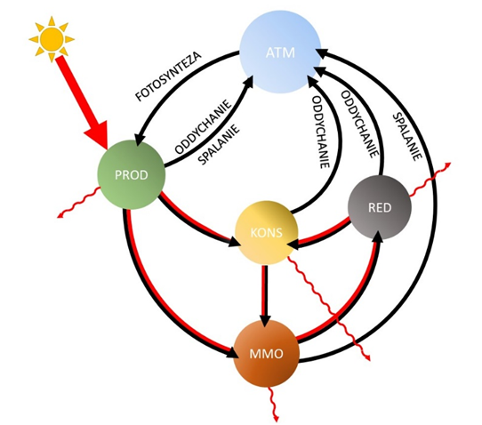
Życie na Ziemi zamienia powoli energię promieniowania słonecznego (rozproszona i niskiej jakości) na chemiczną (skupiona i wysokiej jakości) w postaci
- żywej masy
- skamieniałej masy (ropa, węgiel, gas)
Uproszczony schemat obiegu węgla w środowisku i przepływ przez nie energii. Kolor czarny – strumień węgla, kolor czerwony – strumień energii, PROD – producenci (rośliny), KONS – konsumenci (zwierzęta), MMO – martwa materia organiczna, RED – reducenci, ATM - atmosfera (Autor K. Harenda).

Slide 4
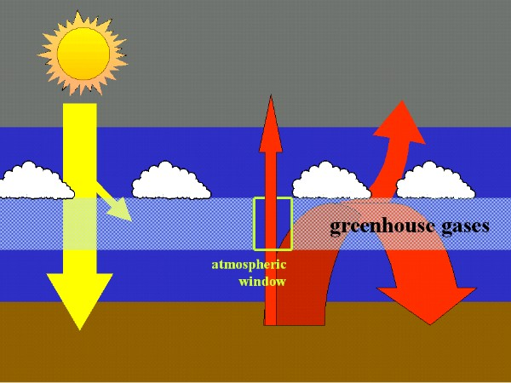
Greenhouse effect
8-14 µm

Slide 5
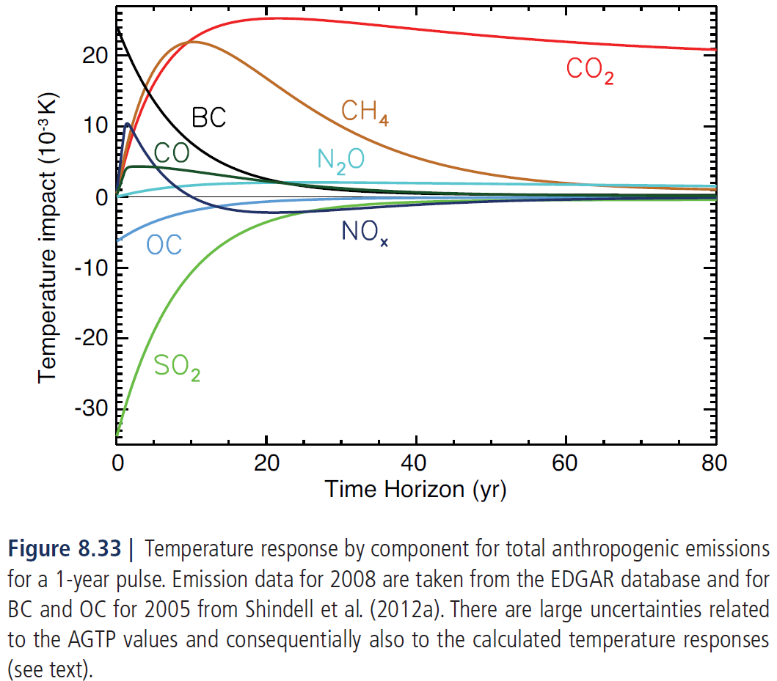
Koncepcja zrównoważonego rozwoju
1-year pulse efect

Slide 6
WYMUSZENIE RADIACYJNE
Wymuszenie radiacyjne - jest to zmiana wartości netto irradiacji (wyrażone w Wm⁻²) liczona na poziomie tropopauzy wywołane zewnętrznymi czynnikami wywołującymi zmiany klimatyczne np. zmiana w zawartości CO₂ lub intensywność promieniowania Słońca.

Slide 7
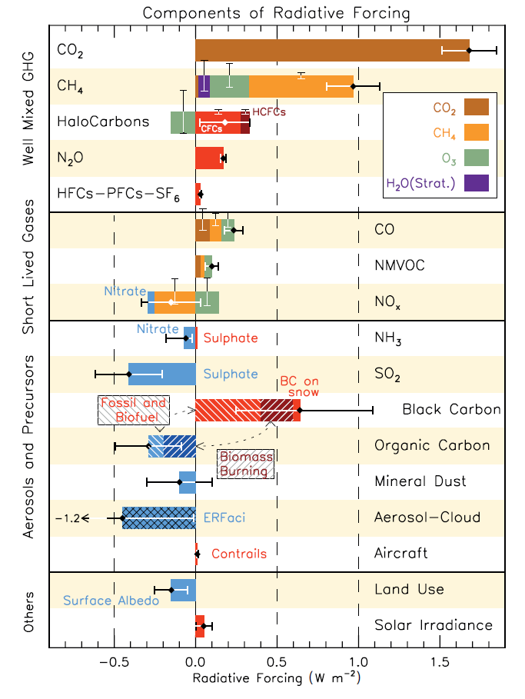
Radiative Forcing for the period 1750–2011
Gasses

Slide 8
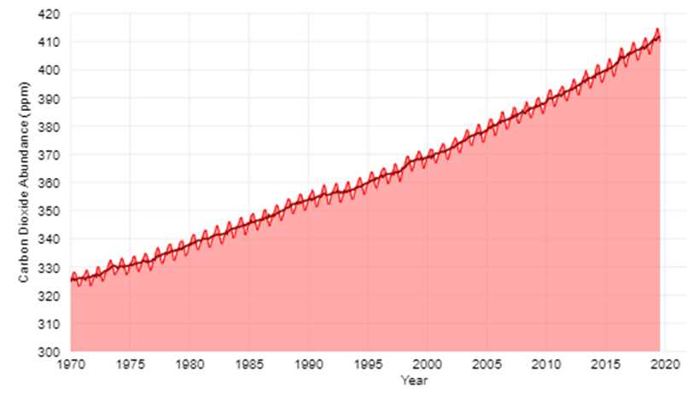
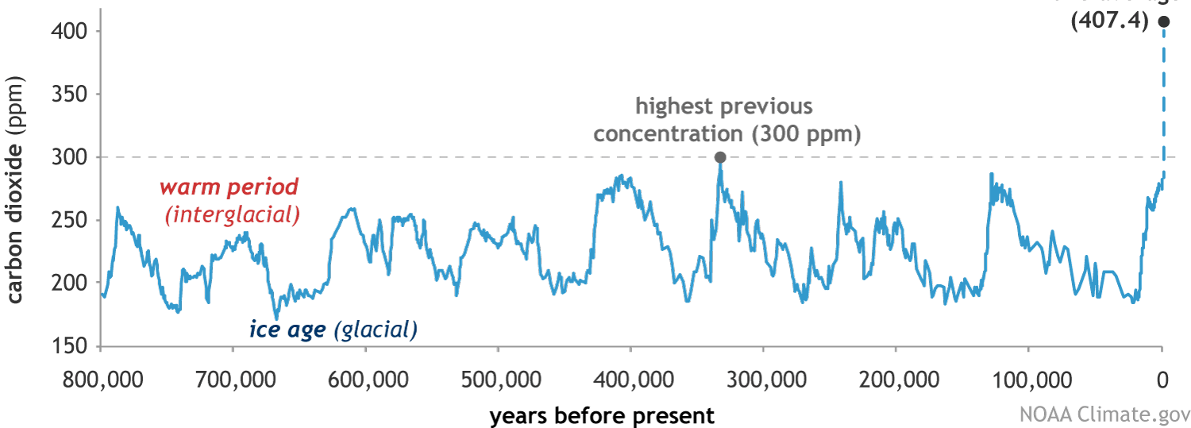
Carbon dioxide
CO₂ concentration 280 -> 407 ppm
Lifetime : 5-200 years

Slide 9
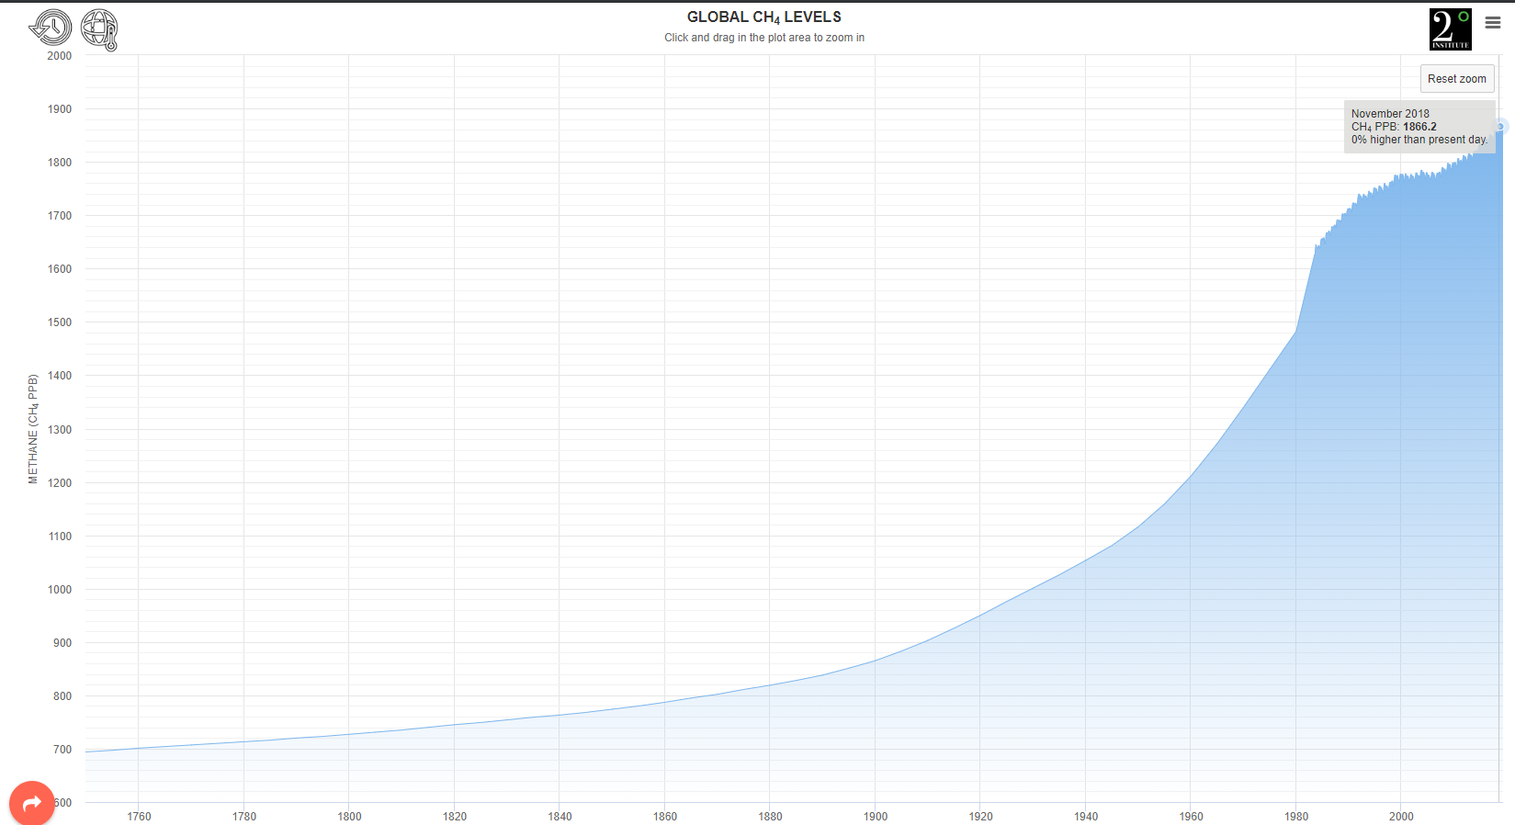
Methane (GWP 28)
CH₄ concentration 700 -> 1866 ppb
Lifetime : 12.4 years

Slide 10
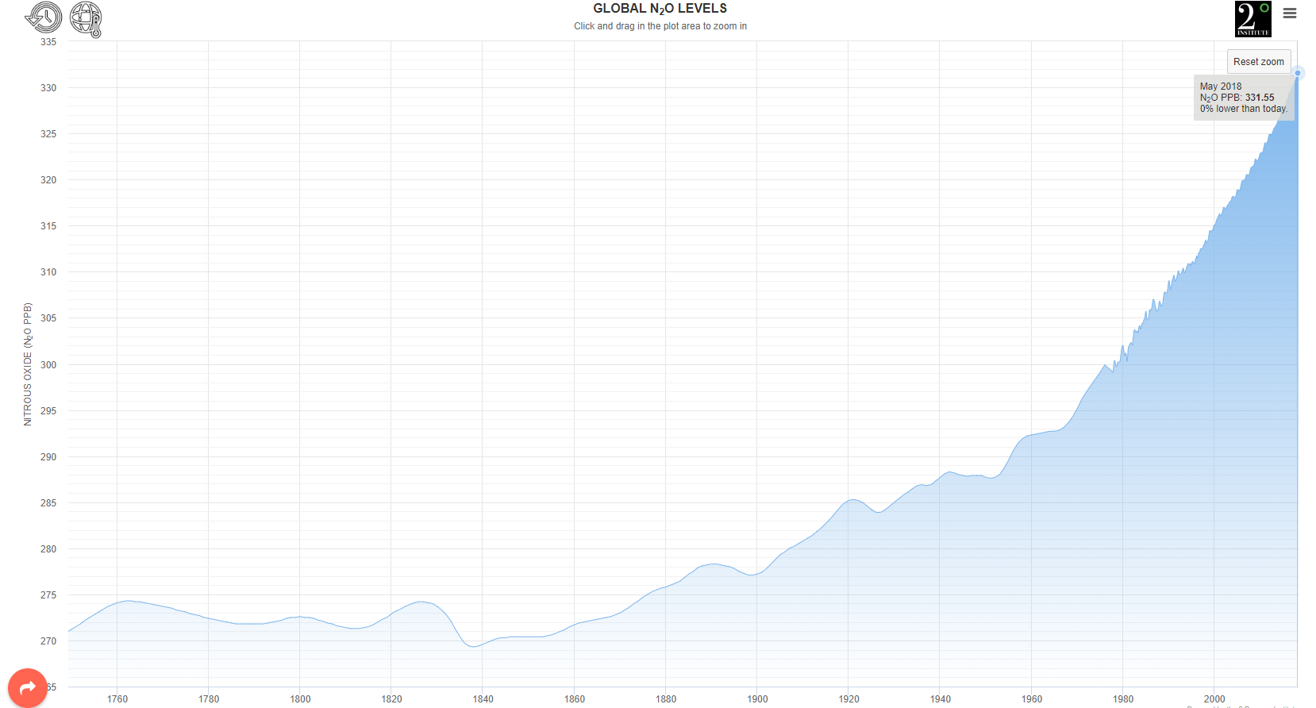
Nitrous oxide (GWP 265)
N₂O concentration 270->321 ppb
Lifetime : 121 years

Slide 11
Aerosols
The atmosphere of Earth contains aerosols of various types and concentrations, including quantities of:
natural inorganic materials: fine dust, sea salt, or water droplets
natural organic materials: smoke, pollen, spores, or bacteria
anthropogenic products of combustion such as: smoke, ashes or dusts
Aerosols can be found in urban ecosystems in various forms:
Dust
Cigarette smoke
Mist from aerosol spray cans
Soot or fumes in car exhaust

Slide 12
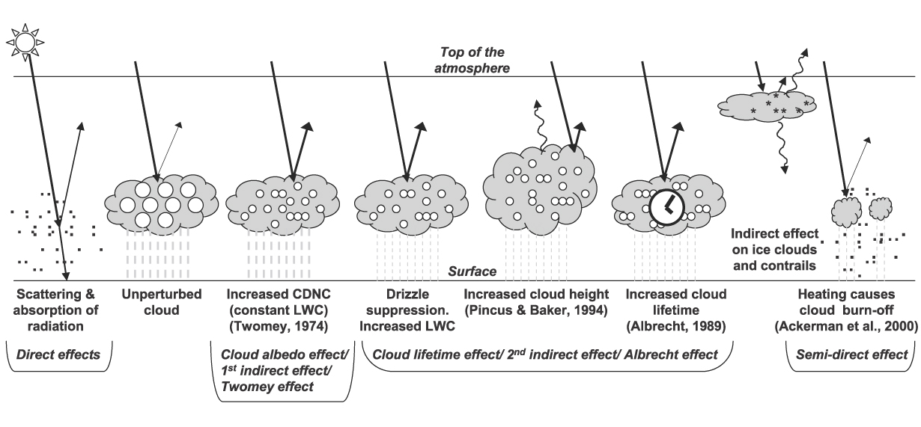
Aerosol’s direct and indirect effects

Slide 13
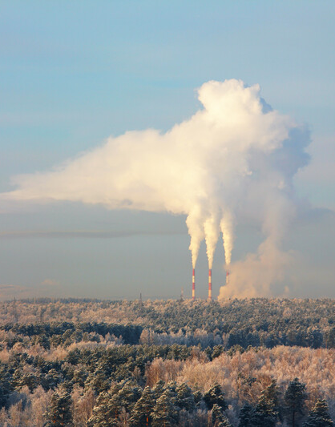
Sulfate

Slide 14
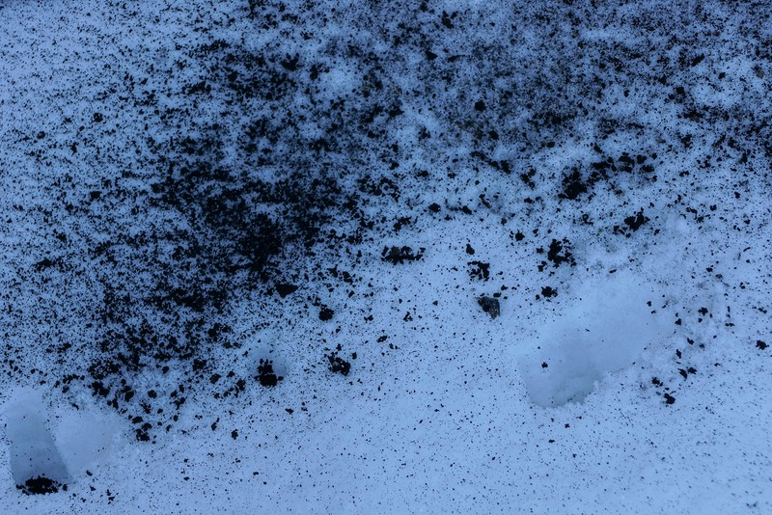
Black carbon on snow

Slide 15

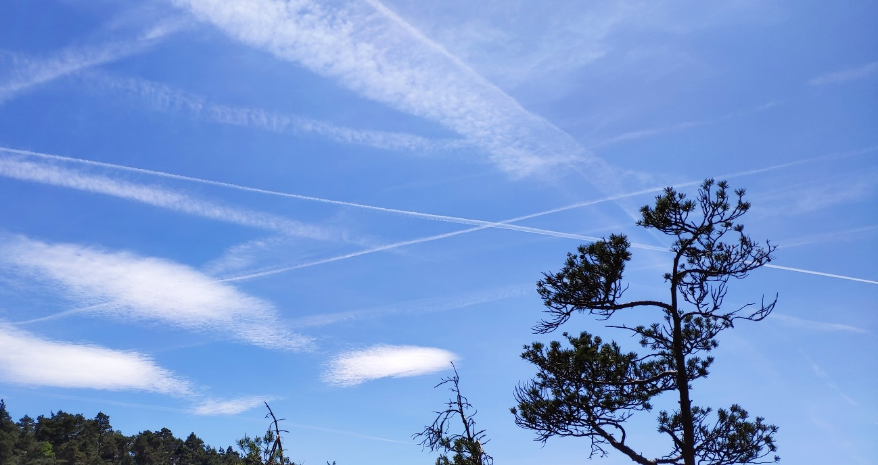
Contrails

Slide 16
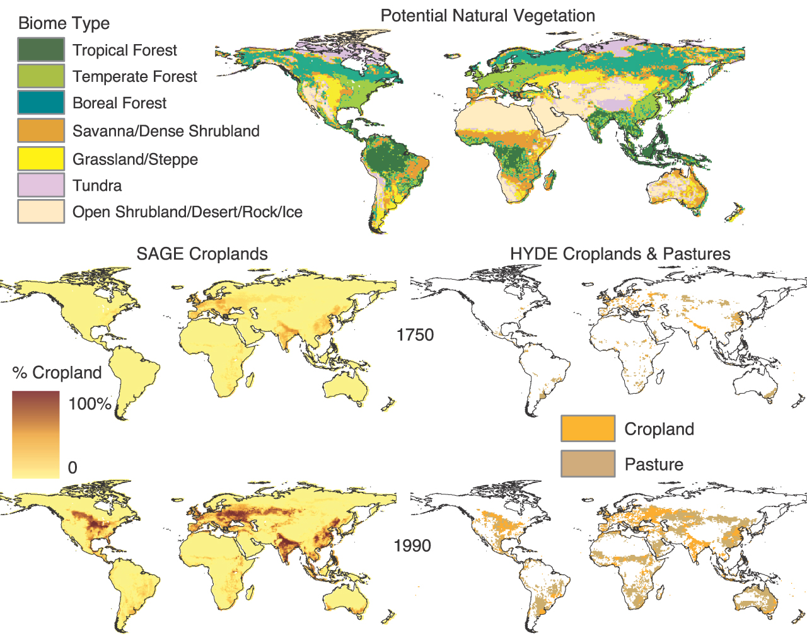
Land use
1750
7.9 – 9.2 millions km²
↓
1990
45.7 – 51.3 millions km²
(35-39% of terrestrial surface)
Forest area reduced by 11%)
Biodiversity

Slide 17
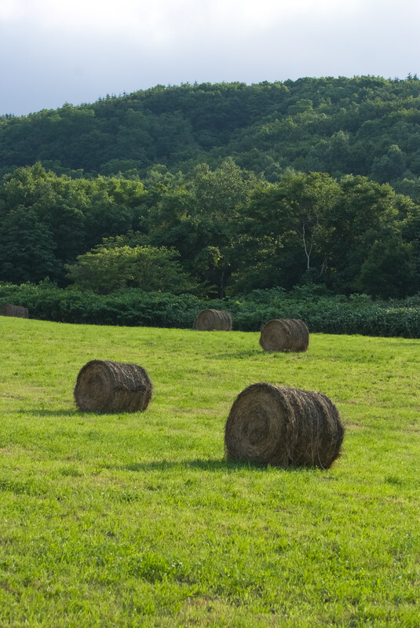
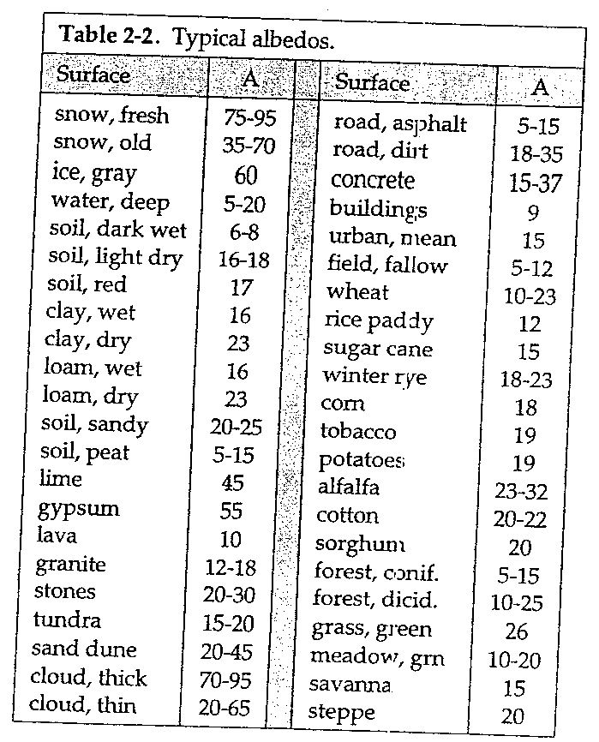

Land use

Slide 18
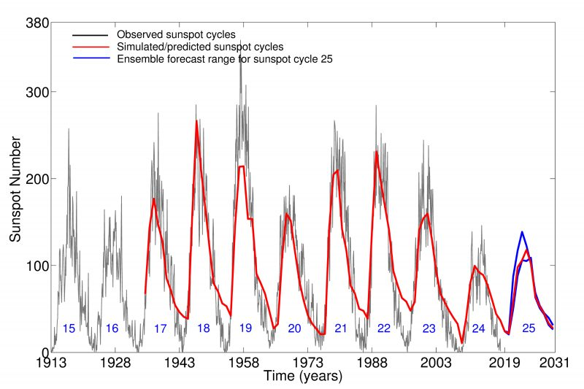
Solar irradiance
(Bhowmik & Nandy 2018)

Slide 19
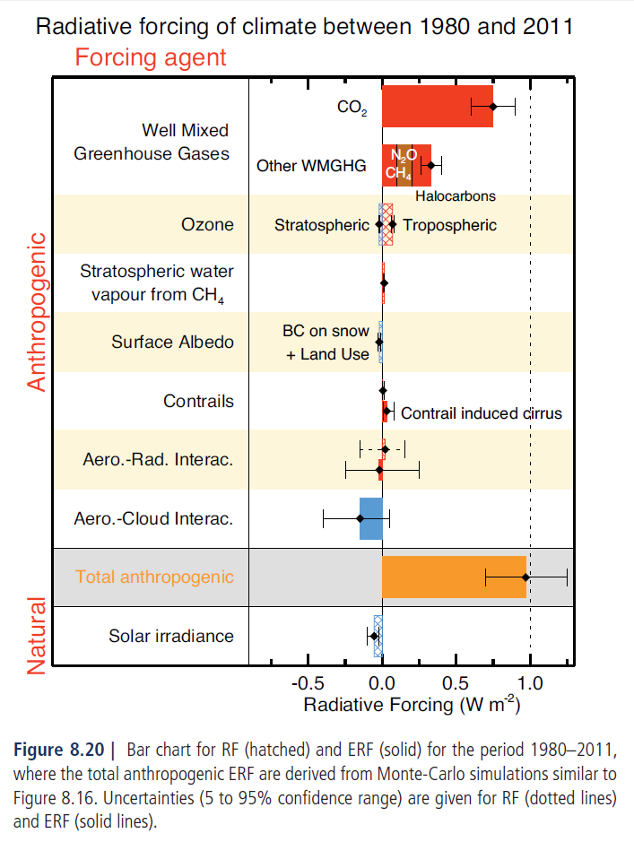
Radiative Forcing for the period 1980–2011
Figure 8.20 | Bar chart for RF (hatched) and ERF (solid) for the period 1980–2011, where the total anthropogenic ERF are derived from Monte-Carlo simulations similar to Figure 8.16. Uncertainties (5 to 95% confidence range) are given for RF (dotted lines) and ERF (solid lines).

Slide 20
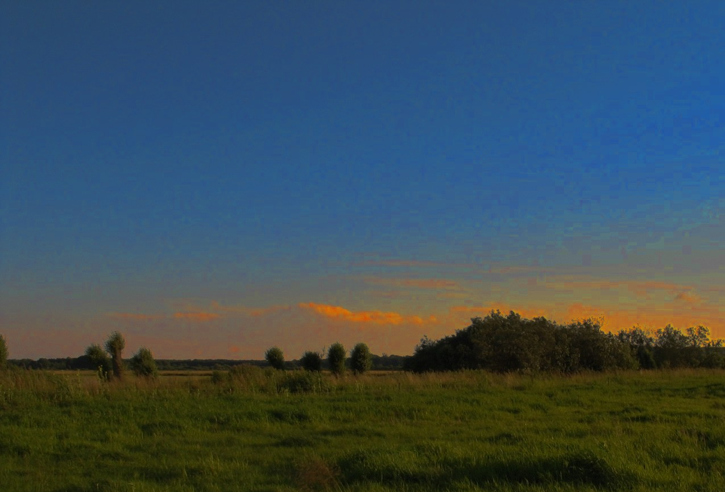
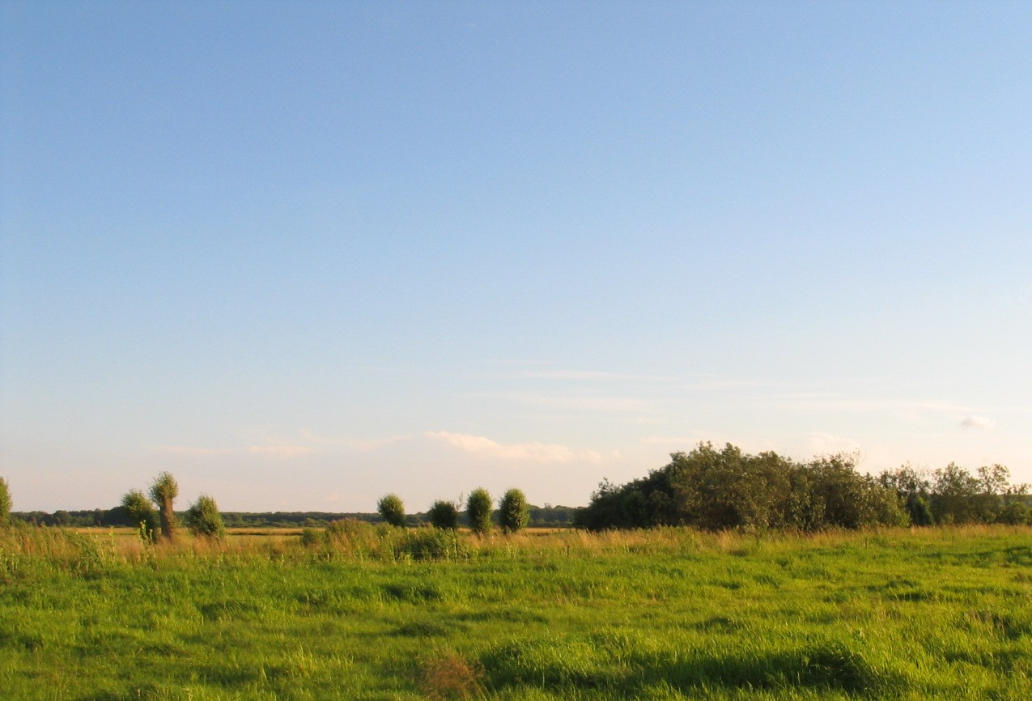

CO₂ fluxes night/day

Slide 21
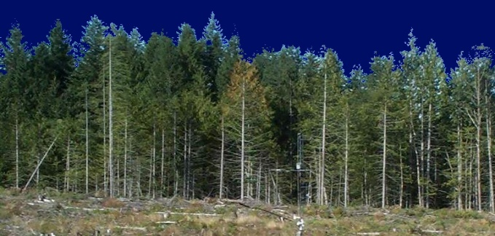
Technika Kowariancji wirów
Based on measurement of fluctuations of wind speed & temperature, humidity or CO₂ concentration
Eddies are “carriers” of these entities
Vertical transport requires some correlation between the entity & vertical velocity
Wind velocity
Surface boundary layer

Slide 22

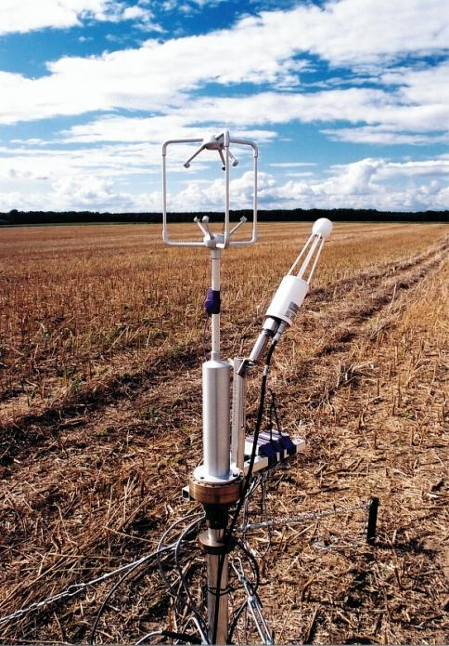
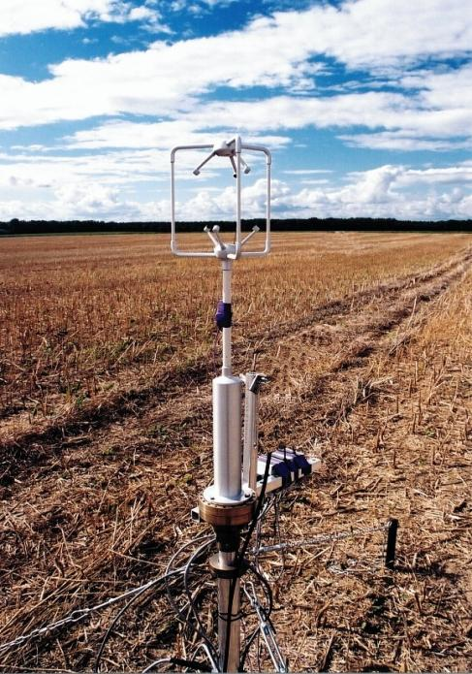

TURBULENCE IN THE ATMOSPHERE
w
Time
ρC
Time

Slide 23
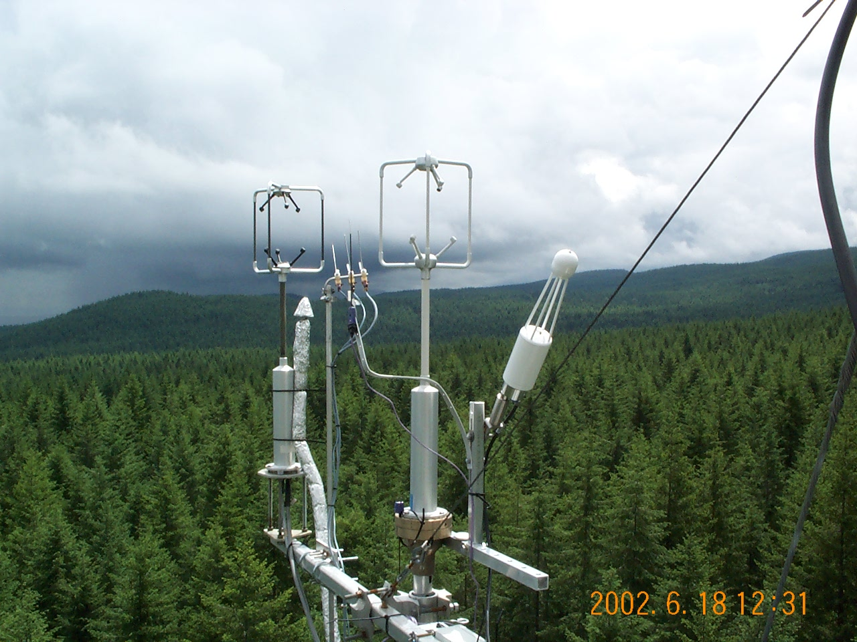
EC intercomparison experiment
Poznan open path vs. UBC closed path systems

Slide 24
Correlation between scalars
The three scalars are strongly correlated.
Upward moving air is moist, warm and CO₂ depleted.

Slide 25
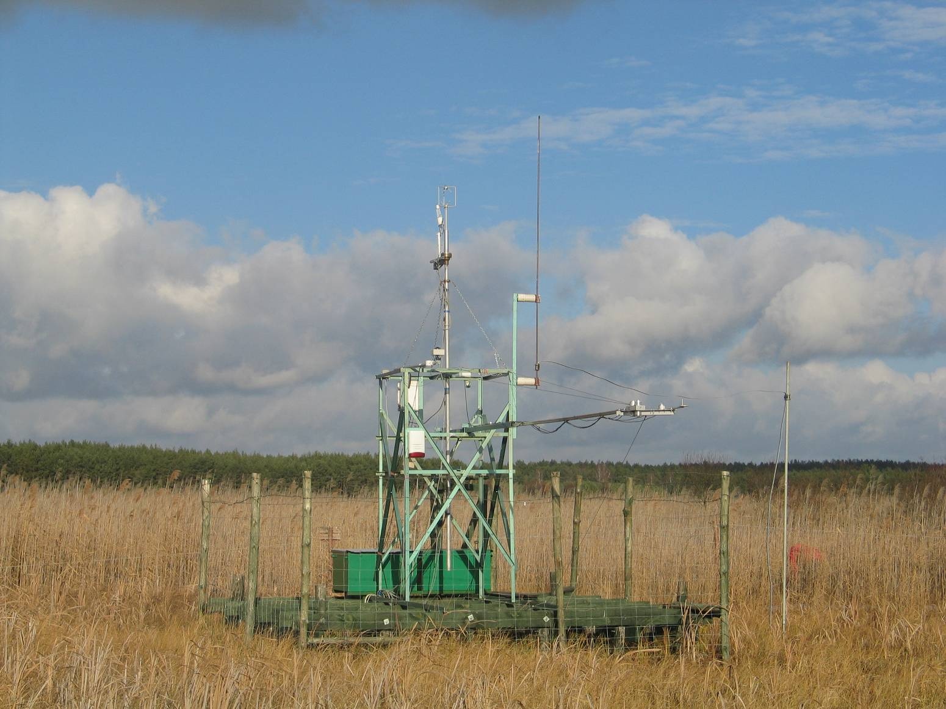
Eddy Covariance System Rzecin

Slide 26
Technika komorowa

Slide 27
Chamber measurements
Konzentration
Zeit
Gasanalysator

Slide 28
Diurnal NEE vs. PPFD relationship
Model 1: Smith; Model 2: Michaelis – Menten; Mode 3: Misterlich;
Measure.
Notes:
The measurements where U* was below 0.1 m*s-1 were excluded from the analysis.
Yearly data set was divided into monthly periods.
Then diurnal and nocturnal data were distinguished using Rg as a criterion. When Rg >5 Wm-2 then data was treated as diurnal and Rg<5 Wm-2 was nighttime indicator.
The logaritmic fuctions were developed for diurnal Fc versus Rg relationships

Slide 29


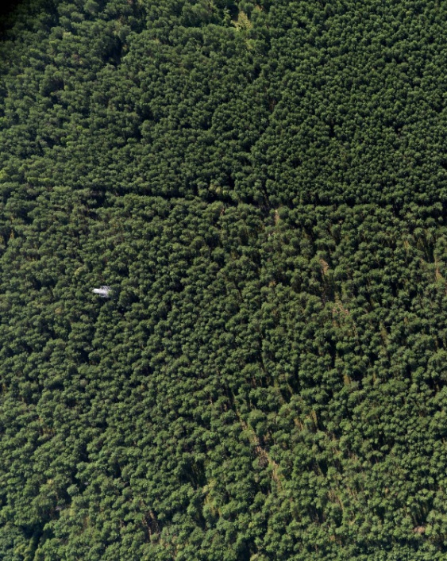
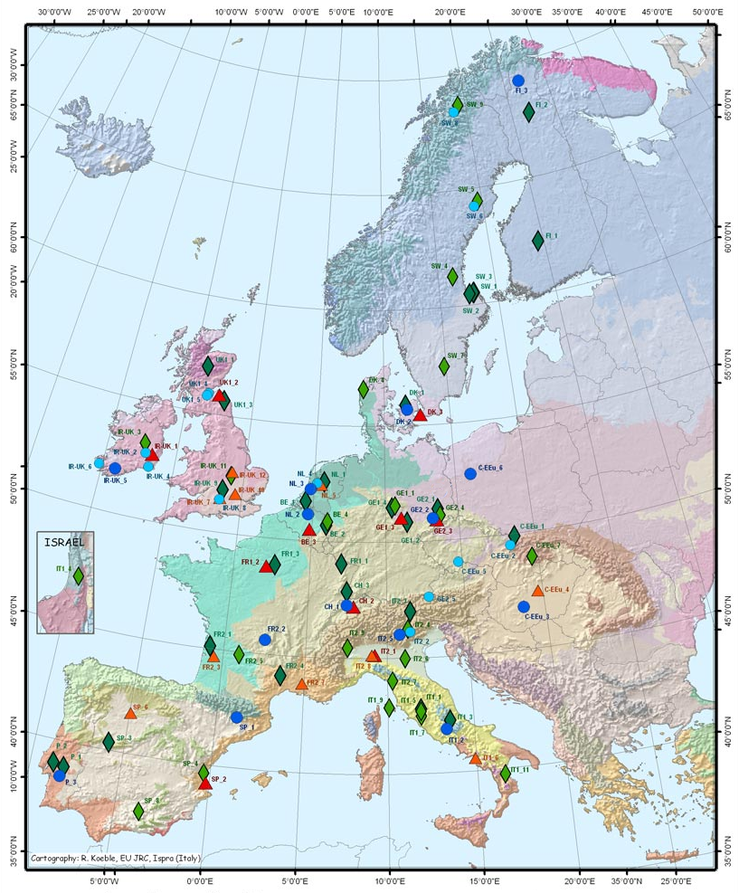
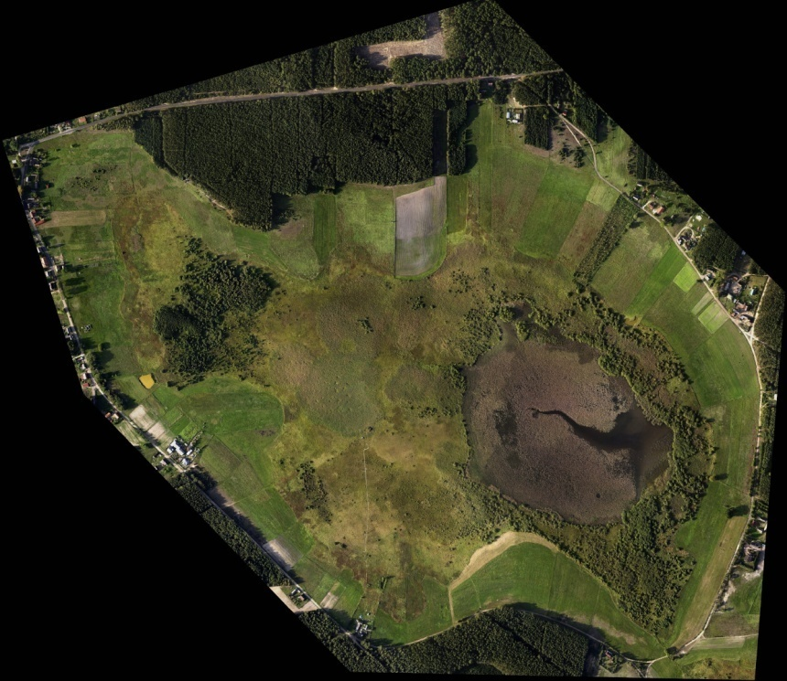


PULS sites
TUCZNO
Wetland/Grassland
Arable land
Forest
POLWET
GDLP
C-FOREST

Slide 30
Dziękuję za uwagę

